Slide 1
Digital Portfolio
STUDENT NAME: NISHA.P
REGISTER NO AND NMID: 2426J1533 & asbruaz2426j1533
DEPARTMENT: B.SC.INFORMATION TECHNOLOGY
COLLEGE: KPR COLLEGE OF ARTS SCIENCE AND RESEARCH /BHARATHIYAR UNIVERSITY

Slide 2
PROJECT TITLE AI-Powered Resume Builder — Project Report & Presentation

Slide 3


AGENDA
Problem Statement
Project Overview
End Users
Tools and Technologies
Portfolio design and Layout
Features and Functionality
Results and Screenshots
Conclusion
Github Link
3/21/2024 Annual Review

Slide 4

PROBLEM STATEMENT Creating a professional resume is often time-consuming and challenging for students and professionals. Many lack knowledge of modern formats, keyword optimization, and design aesthetics. Goal: Build an AI-powered web application that auto-generates a personalized, ATS-friendly (Applicant Tracking System) resume with minimal user input.

Slide 5

PROJECT OVERVIEW What this project delivers: --→ AI-based system to suggest resume content (e.g., skills, summary, achievements). --→ Multiple template options with modern design layouts. --→ Real-time preview and downloadable PDF. --→ Cloud-based storage for saving and editing resumes.

Slide 6

WHO ARE THE END USERS?
Students applying for internships or higher education.
Job-seekers and early-career professionals.
Career counselors and placement cells.
Recruiters looking for well-structured resumes.

Slide 7

TOOLS AND TECHNIQUES Frontend : React.js, Tailwind CSS, HTML5, CSS3, JavaScript Backend : Node.js / Firebase AI Integration : OpenAI API / ML models for skill suggestions & content generation Database : Firebase Firestore / MongoDB Hosting : Netlify / Vercel / GitHub Pages

Slide 8
POTFOLIO DESIGN AND LAYOUT
Structure:
Landing Page (Intro + Start Resume Button)
Form Sections: Personal Info, Skills, Education, Experience
AI Suggestion Panel: Pre-filled text suggestions based on user input
Resume Preview Panel: Live preview with templates
Download & Share Options
Design principles: Minimalist UI, readable fonts, responsive design, easy navigation
8

Slide 9
FEATURES AND FUNCTIONALITY
AI-powered suggestions for resume content.
Multiple professional templates to choose from.
Real-time resume preview.
One-click PDF download.
Resume storage for future editing.
Keyword optimization for ATS compliance.

Slide 10
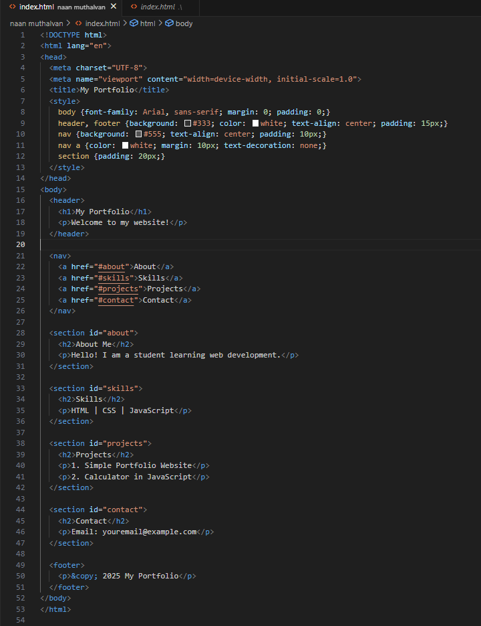
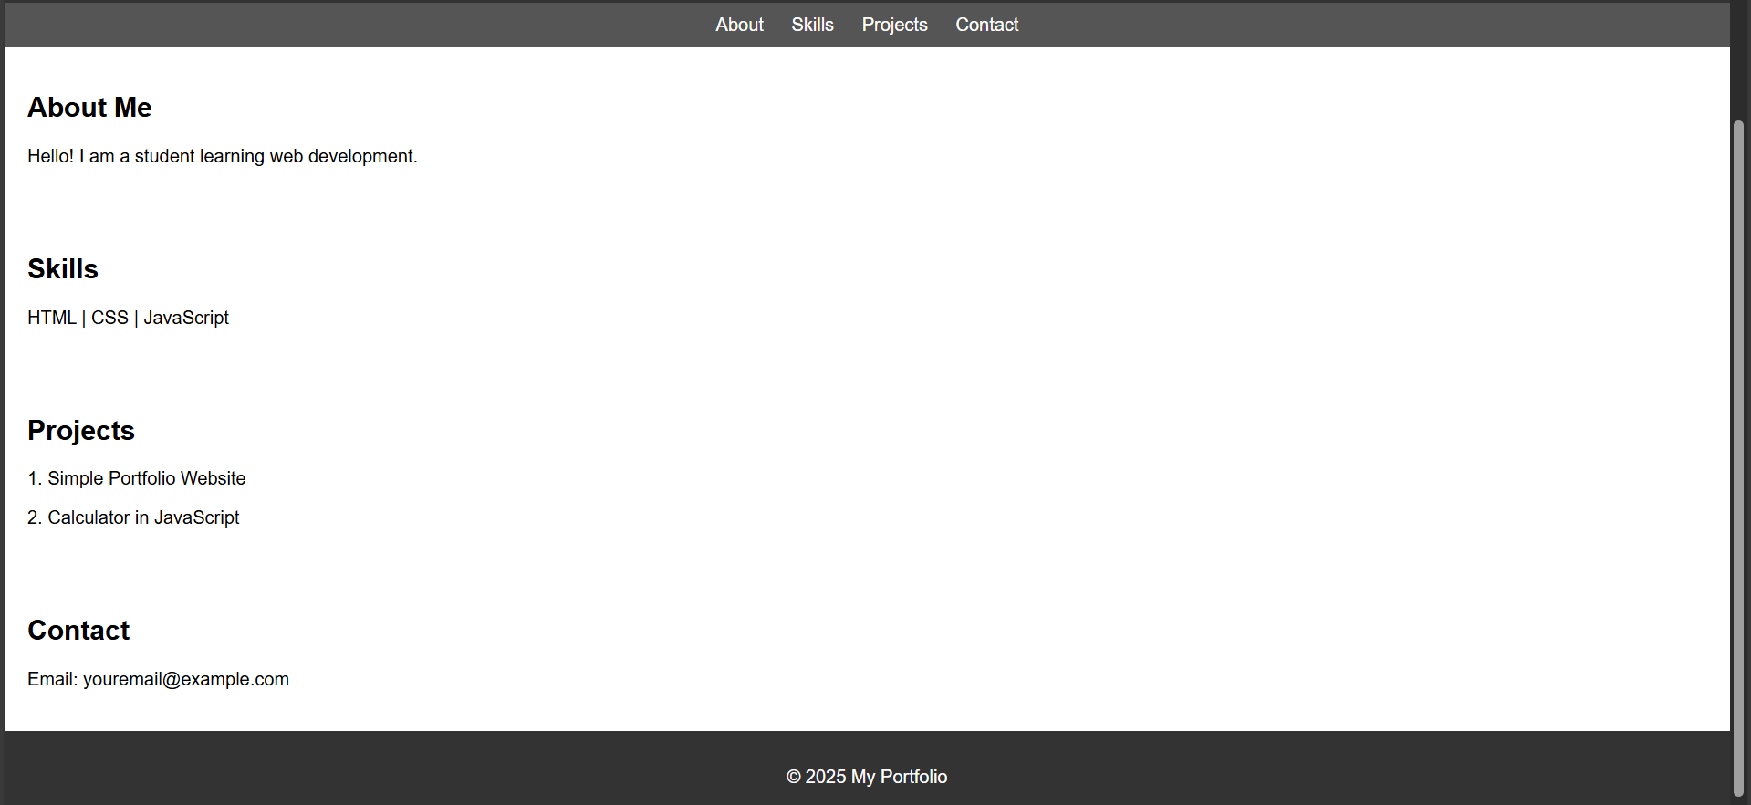
RESULTS AND SCREENSHOTS
3/21/2024 Annual Review
10

Slide 11
CONCLUSION The AI-powered Resume Builder simplifies resume creation. Provides professional, ATS-friendly designs with AI-generated content. Helps users save time and improve job application success rates. Future enhancements: Multi-language support, LinkedIn auto-import, resume scoring system.
11

